Slide 1
Data Structure and Algorithms II
CSE 2217
Instructor: Tahmid Mosaddeque
Department of CSE, UIU

Slide 2
Disjoint Set/Union Find

Slide 3
Dynamic connectivity
Given a set of objects
  Union: connect two objects.
  Connected: is there a path connecting the two objects?
union(3, 4)
union(8, 0)
union(2, 3)
6
5
1
union(5, 6)
connected(0, 2) no
connected(2, 4) yes
2
3
4
union(5, 1)
union(7, 3)
union(1, 6)
union(4, 8)
0
7
8
connected(0, 2) yes

Slide 4
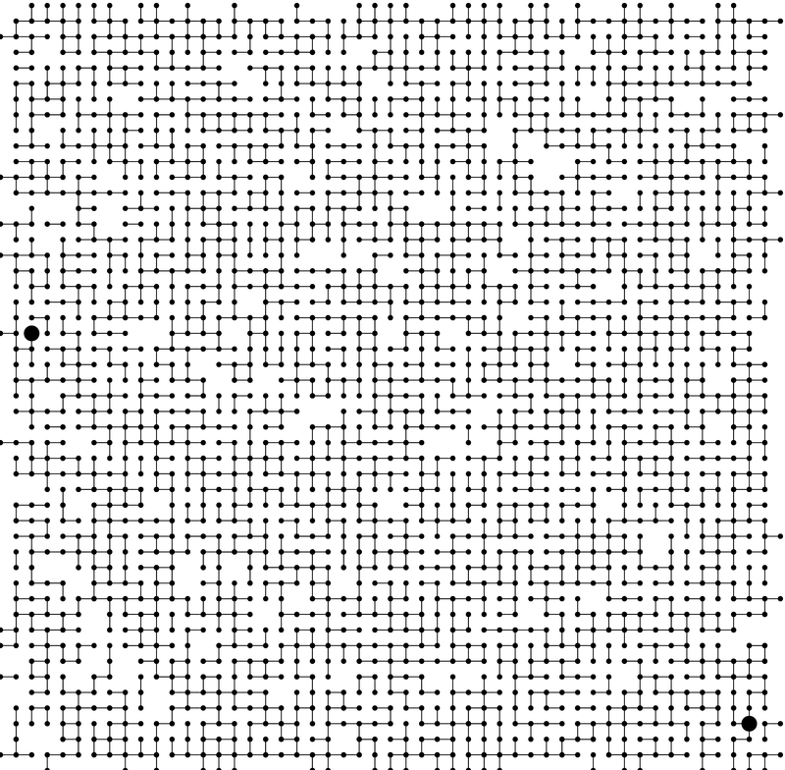
Q. Is there a path from p to q?
p
q
A. Yes.
Notes:
medium.txt (625 sites, 900 edges, 3 connected components)

Slide 5
Representing a tree
For each node
  Keep the id of the parent
Who is the root of the node?
  The node which has a parent equal to a special value
    -1
    0 (is nodes are identified by 1 to N)
    Itself (most used approach)

Slide 6
Modeling the objects
Dynamic connectivity applications involve manipulating objects of all types.
  Pixels in a digital photo.
  Computers in a network.
  Friends in a social network.
  Transistors in a computer chip.
  Elements in a mathematical set.
When programming, convenient to name objects 0 to N-1.
  Use integers as array index.
  Suppress details not relevant to union-find.
Notes:
Manhattan sewers, McCosh rooms

Slide 7
Modeling the connections
We assume "is connected to" is an equivalence relation:
  Reflexive: p is connected to p.
  Symmetric: if p is connected to q, then q is connected to p.
  Transitive: if p is connected to q and q is connected to r,
  then p is connected to r.
Connected components. Maximal set of objects that are mutually connected.
0
1
2
3
4
5
6
7
{ 0 } { 1 4 5 } { 2 3 6 7 }
3 connected components
Notes:
Simple model captures the essential nature of connectivity.
equivalence relation partitions objects into equivalence classes
sets = connected components = equivalence class

Slide 8
Implementing the operations
Find query: Check if two objects are in the same component.
Union command: Replace components containing two objects with their union.
union(2, 5)
0
1
2
3
0
1
2
3
4
5
6
7
4
5
6
7
{ 0 } { 1 4 5 } { 2 3 6 7 }
{ 0 } { 1 2 3 4 5 6 7 }
3 connected components
2 connected components

Slide 9
Union-find data type (ADT)
Goal. Design efficient data structure for union-find.
  Number of objects N can be huge.
  Number of operations M can be huge.
  Find queries and union commands may be intermixed.
public class UF
 | UF(int N) | initialize union-find data structure with N objects (0 to N-1)
void | union(int p, int q) | add connection between p and q
boolean | connected(int p, int q) | are p and q in the same component?
int | find(int p) | component identifier for p (0 to N-1)
int | count() | number of components

Slide 10
Quick-find [eager approach]
Data structure.
  Integer array id[] of size N.
  Interpretation: p and q in same component iff they have the same id.
i 0 1 2 3 4 5 6 7 8 9
id[i] 0 1 9 9 9 6 6 7 8 9
5 and 6 are connected
2, 3, 4, and 9 are connected
0
1
2
3
4
5
6
7
8
9

Slide 11
Quick-find [eager approach]
  Find: Check if p and q have the same id.
i 0 1 2 3 4 5 6 7 8 9
id[i] 0 1 9 9 9 6 6 7 8 9
5 and 6 are connected
2, 3, 4, and 9 are connected
id[3] = 9; id[6] = 6
3 and 6 in different components
0
1
2
3
4
5
6
7
8
9
Notes:
find is fast because you just look up two array entries

Slide 12
Quick-find [eager approach]
Union: To merge sets containing p and q, change all entries with id[p] to id[q].
0
1
2
3
4
5
6
7
8
9
i 0 1 2 3 4 5 6 7 8 9
id[i] 0 1 6 6 6 6 6 7 8 6
union of 3 and 6
2, 3, 4, 5, 6, and 9 are connected
problem: many values can change
Notes:
challenge is updating data structure to maintain this property
Note: could also update all entries with id[q] to id[p]

Slide 13
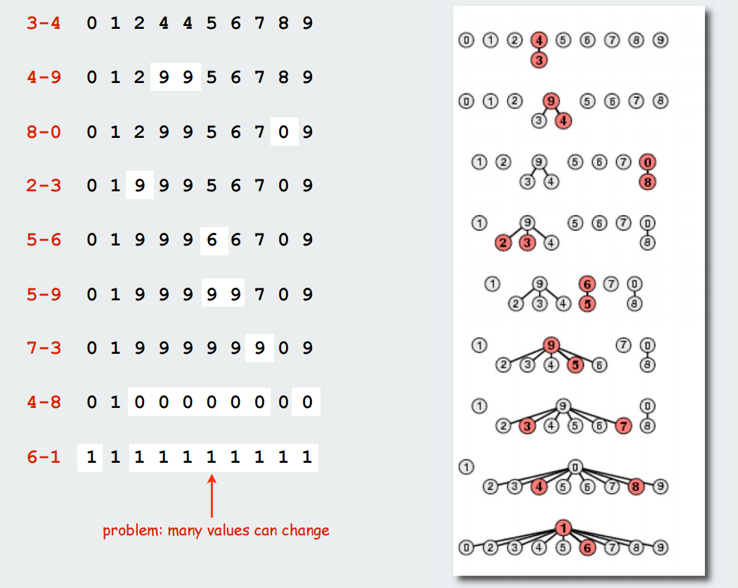
Quick-find example

Slide 14
Quick-find is too slow
Cost model. Number of array accesses (for read or write).
Quick-find Cons:
  Union too expensive.
  Trees are flat, but too expensive to keep them flat.
  Ex. Takes N² array accesses to process sequence of N union commands on N objects.
algorithm | init | union | find
quick-find | N | N | 1
Notes:
this is order-of-growth of number of array accesses - we discard constants

Slide 15
Quick-union [lazy approach]
keep going until it doesn’t change
Data structure.
  Integer array id[] of size N.
  Interpretation: id[i] is parent of i.
  Root of i is id[id[id[...id[i]...]]].
0
1
9
6
7
8
2
4
5
q
p
3
i 0 1 2 3 4 5 6 7 8 9
id[i] 0 1 9 4 9 6 6 7 8 9
Union:
2 9
3 4
4 9
5 6
3's root is 9; 5's root is 6
Notes:
3s parent is 4, 4s parent is 9
could use parent pointer/reference instead of id[] array, but array easier if objects are 0..N-1

Slide 16
Quick-union [lazy approach]
Find. Check if p and q have the same root.
0
1
9
6
7
8
i 0 1 2 3 4 5 6 7 8 9
id[i] 0 1 9 4 9 6 6 7 8 9
2
4
5
q
p
3
3's root is 9; 5's root is 6
3 and 5 are in different components

Slide 17
Quick-union [lazy approach]
Union. To merge sets containing p and q, set the id of p's root to the id of q's root.
Union (3,5)
0
1
9
6
7
8
2
4
5
q
i 0 1 2 3 4 5 6 7 8 9
id[i] 0 1 9 4 9 6 6 7 8 9
3
p
3's root is 9; 5's root is 6
3 and 5 are in different components
i 0 1 2 3 4 5 6 7 8 9
id[i] 0 1 9 4 9 6 6 7 8 6
0
1
6
7
8
9
5
q
only one value changes
2
4
p
3
Notes:
only have to change one array entry to execute union, but price you pay is traveling up tree to find roots.

Slide 18
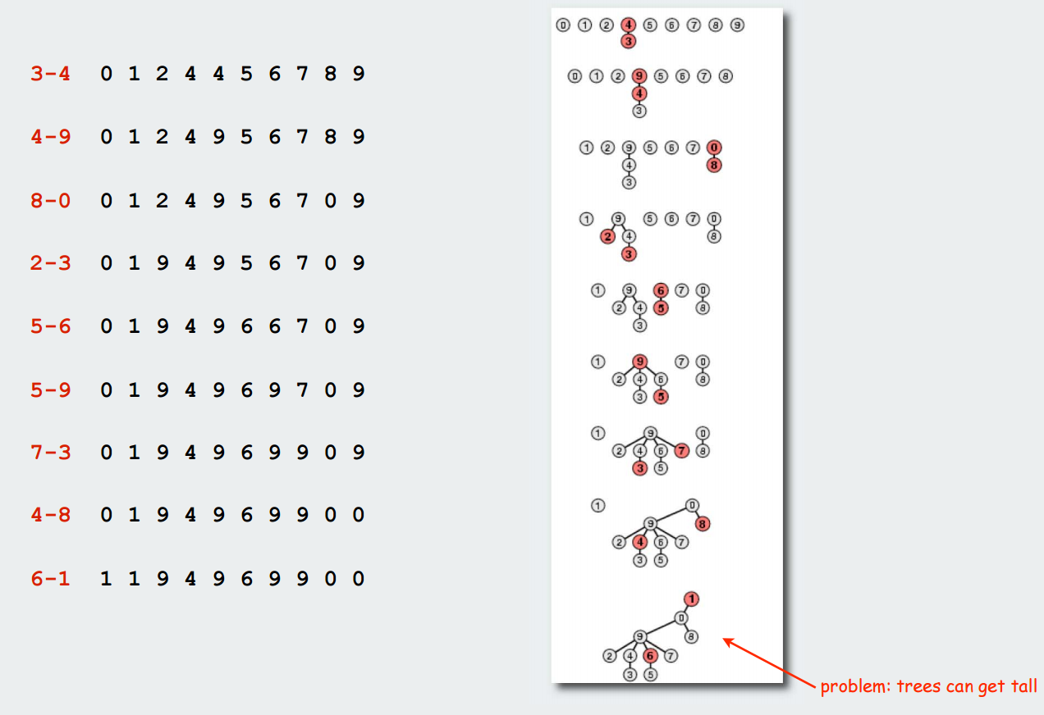
Quick-union example

Slide 19
Quick-union is slow too!
Cost model. Number of array accesses (for read or write).
Quick-find defect.
  Union too expensive (N array accesses).
  Trees are flat, but too expensive to keep them flat.
Quick-union defect.
  Trees can get tall.
  Find too expensive (could be N array accesses).
algorithm | init | union | find
quick-find | N | N | 1
quick-union | N | N | N
worst case

Slide 20
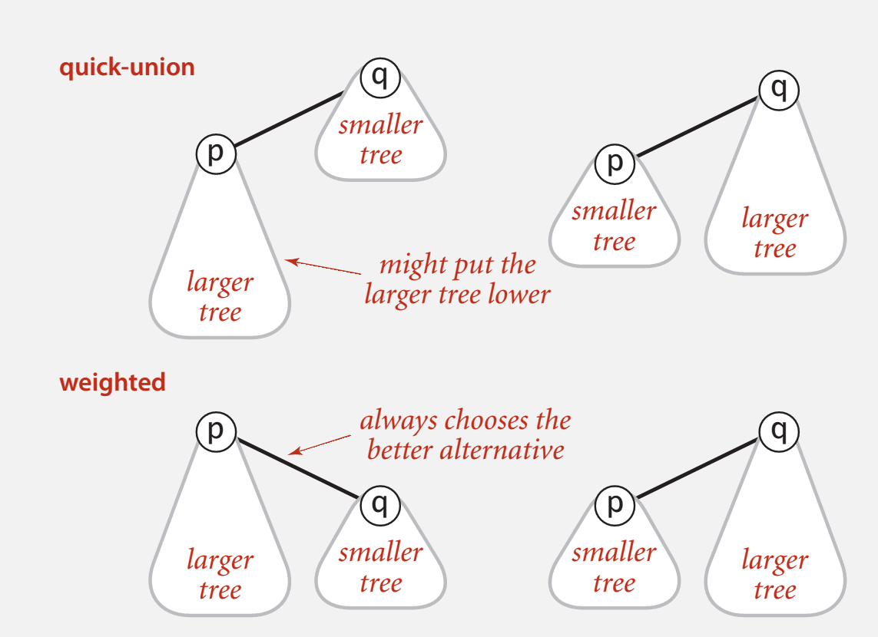
Improvement 1: Weighting
Weighted quick-union.
  Modify quick-union to avoid tall trees.
  Keep track of size of each tree (number of objects).
  Balance by linking small tree below large one.

Slide 21
Weighted quick-union: implementation
Data structure. Same as quick-union, but maintain extra array sz[i]. to count number of objects in the tree rooted at i.
Find. Identical to quick-union.
Union. Modify quick-union to:
  Merge smaller tree into larger tree.
  Update the sz[] array.

Slide 22
Weighted quick-union analysis
Running time.
  Find: takes time proportional to depth of p and q.
  Union: takes constant time, given roots.
Proposition. Depth of any node x is at most log₂ N.
1
0
6
8
9
4
7
N = 10
depth(x) = 3 <= log₂ N
5
2
3
x

Slide 23
Comparison
algorithm | init | union | find
quick-find | N | N | 1
quick-union | N | N | N
weighted QU | N | lg N | lg N

Slide 24
Improvement 2: path compression
Quick union with path compression. Just after computing the root of p,
set the id of each examined node to point to that root.
0
0
1
2
9
6
3
1
2
3
4
5
11
12
8
7
4
5
6
7
10
root(9)
8
9
p
10
11
12

Slide 25
Path compression: implementation
Standard implementation: add second loop to find() to set the id[] of each examined node to the root.
Simpler one-pass variant: halve the path length by making every other node in path point to its grandparent.
int root(int i)
{
while (i != id[i])
{
id[i] = id[id[i]];
i = id[i];
}
return i;
}
only one extra line of code !
Notes:
can avoid second pass by using "halving."

Slide 26
Weighted quick-union with path compression example
visualgo
Make UF (14)
11 9
12 9
10 8
8 6
9 6
7 3
1 4
5 1
1 0
2 0
1 3
6 3
10 13

Slide 27
Summary
algorithm | worst-case time
quick-find | M N
quick-union | M N
weighted QU | N + M log N
QU + path compression | N + M log N
weighted QU + path compression | N + M lg* N
M union−find operations on a set of N objects
Notes:
WQUPC on Java cell phone beats QF on supercomputer!
if we could do this well on every problem, we'd be in great shape! but lots of useful problems where N^2 or N^3 is easy, basic ideas in data structures hammers it to N log N or better.

Slide 28
Disjoint-Set
Keep a collection of sets S₁, S₂, .., S_{k},
  Each S_{i} is a set, e,g, S₁={v₁, v₂, v₈}.
Three operations
  Make-Set(x)-creates a new set whose only member is x.
  Union(x, y) –unites the sets that contain x and y, say, S_{x} and S_{y}, into a new set that is the union of the two sets.
  Find-Set(x)-returns a pointer to the representative of the set containing x.

Slide 29
Study Material
CLRS – Chapter 21

